Slide 1
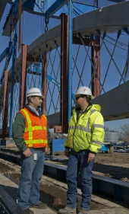
CONTRACTING LOCAL GOVERNMENT PROJECTS

Slide 2
WHAT’S TXDOT GOT TO DO WITH IT?
I was awarded the project, now what?

Slide 3
WHAT IS A LOCAL GOVERNMENT PROJECT?
At least one phase* of project development is:
Federally and/or State funded
Managed by a local government
Reimbursed by the Texas Department of Transportation (TxDOT)
or
Locally funded project on the State system
* planning, environmental, design, ROW, utility relocation, construction

Slide 4
TYPES OF PROJECTS
Bicycle / Pedestrian
Congestion-Mitigation / Air Quality
Traffic Signals
Earmarks
Off-System Bridge
Roadways
Highways, etc.

Slide 5
TXDOT’S RESPONSIBILITY
Federal Highway Administration (FHWA) / TxDOT oversight agreement
Oversight applies to all federal and State funded projects
REIMBURSMENT PROGRAM (potential cash flow issue for LG)
Local government (LG) incurs expense, bills TxDOT
TxDOT pays LG, bills FHWA
Goal is to:
Allow the local government flexibility in administering project, while ensuring compliance with federal / State laws and regulations

Slide 6
HOW DOES TXDOT COOPERATE WITH LOCAL GOVERNMENTS?
Advance Funding Agreement (AFA)
Negotiated contract between TxDOT and LG
Defines the scope of work, project location, and budget
Outlines who will perform:
ROW acquisition
Engineering
Utilities
Environmental
Construction
Maintenance
State oversight fee

Slide 7
ADVANCE FUNDING AGMT DEVELOPMENT (2 – 12 MONTHS)
Local Government (LG) requests Advance Funding Agreement (AFA)
LG concurs with AFA
LG partially executes and returns to District
LG sends check for review costs and schedules kick off meeting
LOCAL GOVERNMENT
no
yes
District prepares draft AFA
District sends to Contract Services (CS) for approval of partial execution
District sends duplicate copies to LG
District sends to CS for full execution
District sends fully executed original to LG
TXDOT HOU DISTRICT
CS reviews / approves for partial execution
CS fully executes, sends copy to FIN, LM, and District
yes
TXDOT CONTRACT SERVICES
no

Slide 8
WHAT’S NEXT?
Secure Federal Project Authorization & Agreement (FPAA) (if applicable)
Send LG fully executed AFA & FPAA with request for initial cash payment
LG sends initial cash payment to State
Project set up in financial system
Project manager assigned
Send Notice to Proceed
Kick-off meeting scheduled

Slide 9
DIGITAL SIGNATURES and DOCUSIGN

Slide 10
Digital Signatures
The term Digital Signature is used to describe
a signature system applied to an electronic document
that utilizes specific technical processes
to provide significant added security, authentication, and/or encryption.

Slide 11
Digital Signatures
Why Use Digital Signatures?
IT IS MUCH FASTER
Secure digital signatures cannot be repudiated.
Increases Departmental efficiency by reduction in paper handling, routing and scanning.
Maintains the data in a digital format & cannot be repudiated.
IT IS MUCH FASTER

Slide 12
Digital Signatures
Are Digital Signatures Legal in Texas?
YES.
A record or signature may not be denied legal effect or enforceability solely because it is in electronic form. Texas Business and Commerce Code Sec. 322.007(a)
If a law requires a signature, an electronic signature satisfies the law. Texas Business and Commerce Code Sec. 322.007(d)
See also 15 U.S. Code § 7001

Slide 13
DocuSign
What is DocuSign?
A digital signature service that is legal in Texas and compliant with DIR guidelines.
TxDOT purchased DocuSign through DIR.
DocuSign is a secure, software tool that can be used to create and obtain digital signatures. Users can:
Create workflows for signatures,
Track a document in the approval process,
Send reminders, and
Store digitally-signed documents online.

Slide 14
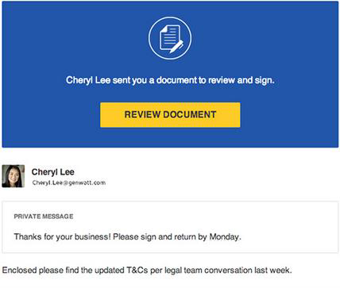
DocuSign
How does DocuSign work?
You will get an email (on any device) from DocuSign requesting your signature.
Click the link in the email, and you will see this screen:

Slide 15
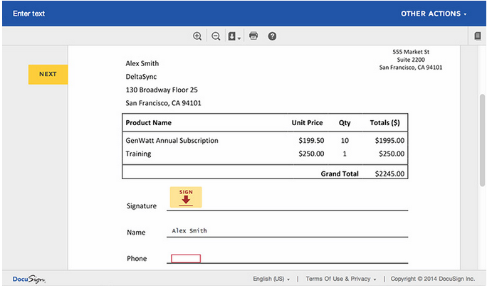
DocuSign
3. Follow the DocuSign tabs.
Tabs and simple instructions guide you through the signing process.

Slide 16
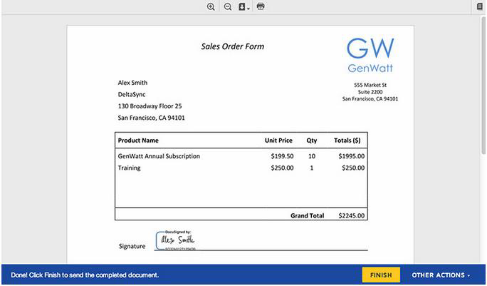
DocuSign
Click “FINISH”.

Slide 17
DocuSign
Once you’ve clicked “FINISH”, the contract has been legally executed in Texas.
DocuSign automatically secures and stores your digital signature, and sends the executed contract back to CSO in electronic format.
CSO will continue to store and archive all digitally-executed contracts.

Slide 18
Contact
Laura Gamboa
Senior Contract Specialist
Texas Department of Transportation | Houston District
Phone | 713.802.5641
E-Mail | Laura.Gamboa@txdot.gov

Slide 19
Questions?

