Slide 1
Solid Waste Management Department
H-GAC Roundtable Glass Recycling
February 23, 2017

Slide 2
Department Mission & Services
Provide cost effective, environmentally sound and safe solid waste services:
Residential Garbage
Junk/Tree Waste
Recycling Services
Curbside Collection
Recycling Centers
Electronic Scrap & Household Hazardous Waste
Yard Waste
Dead Animals
~430,000 direct service customers
Disaster Recovery

Slide 3
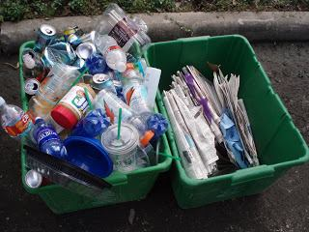
Curbside Recycling History
Curbside recycling began as a pilot program in 1990, with the small 18-gallon bins being provided in large part through donations from local and major corporations;
The original program had only 27,000 homes, which grew to over 200,000 homes with the small dual stream bins before the City began converting and expanding the single stream program.
February 2015, Houston achieved it’s goal of offering curbside recycling to all homes with City solid waste services. A big win!
3

Slide 4
How to Expand Curbside Recycling in Houston
2009 March, pilot 10,000 homes
2009 August, 12,000 homes
2010 January, $3M DOE grant adds 50,000 homes
2010 December, 30,000 homes
2013 July, 33,000 homes
2013 December, 70,000 homes
2014 June, 62,000
2015 February, 109,000 homes
4

Slide 5
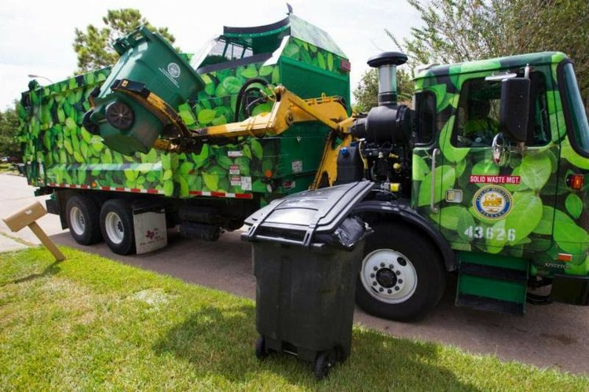
Contracting Timeline
Contract with current processor up for renewal; contract originally signed 2013
Negotiations for renewal terms; namely the removal of the zero floor provision for the cost
Reached an agreement
Changes to program, glass dropped from single stream program
Next steps, RFP out fall 2016 for new contract to follow current

Slide 6
Challenges/Lessons Learned
Communicating industry changes both up and down the chain.
Houstonians love to recycle, and are able to make changes when needed to keep program going.
Leave as much flexibility as possible.

Slide 7
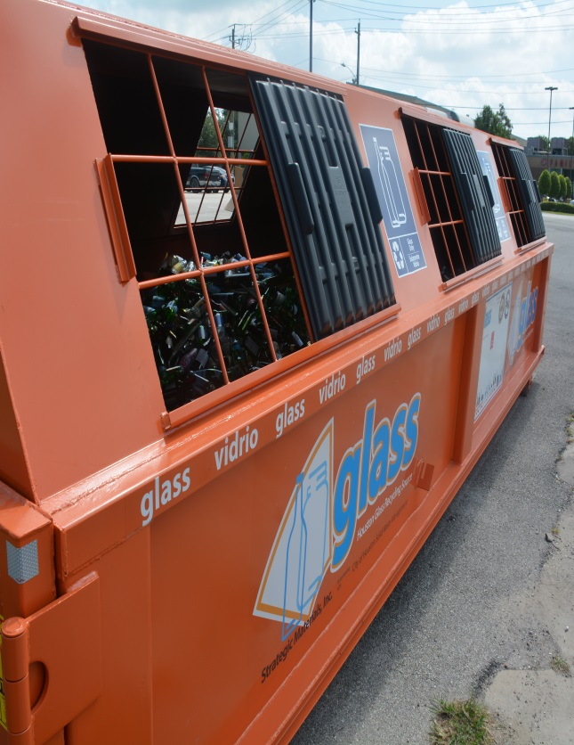
What Are We Doing?
Launched a comprehensive “ No Glass: No Vidrio” program to educate residents about the removal of glass from the curbside recycling program.
Worked with Council members and community associations to assist in delivering the message to residents about removing glass from the recycling “green” bins.
Identifying those areas within the City with high contamination rates in order to present enhanced education programs.
Working with civic associations and church organizations to identify locations that will host glass box collection.

Slide 8
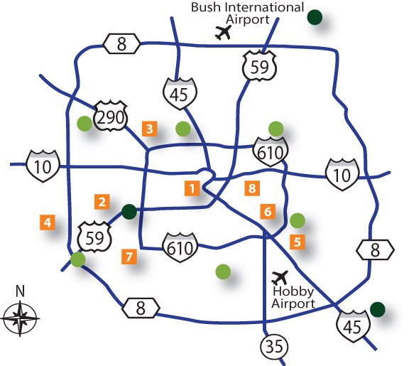
Where Can I Recycle Glass?
Harry Hayes, Director
Sylvester Turner, Mayor
Partnered with Strategic Materials Inc., HPARD, The Salvation Army & HHD to launch a glass drop-off program with locations around the City.
Salvation Army Family Store & Donation Center 2208 Washington Ave, accessible 24 hours
Sharpstown Park 6600 Harbor Town Drive, accessible during park hours
T.C. Jester Park 4201 T C Jester Blvd, accessible during park hours
Alief Community Park 11903 Bellaire Blvd, accessible during park hours
Glenbrook Golf Course 8205 N Bayou Dr, accessible during park hours
Mason Park 541 S 75th St, accessible during park hours
Westbury Methodist Church 5200 Willowbend Blvd, accessible during business hours
We Can Recycle 723 N Drennan St, accessible during business hours
Community Glass Recycling Drop-off Centers
City Neighborhood Drop-off Centers
City Neighborhood Depository/Recycling Centers

Slide 9
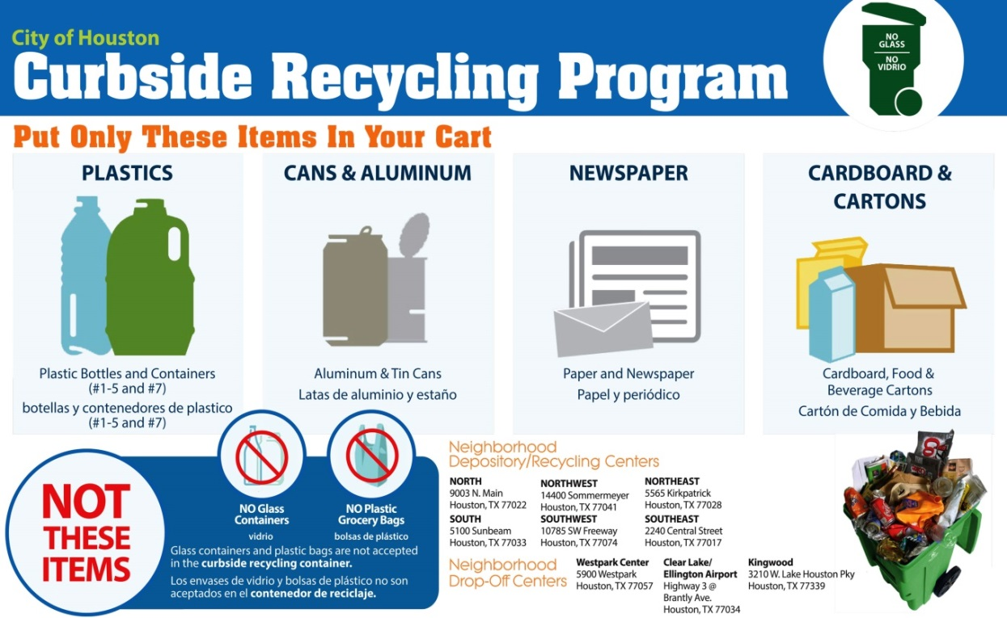
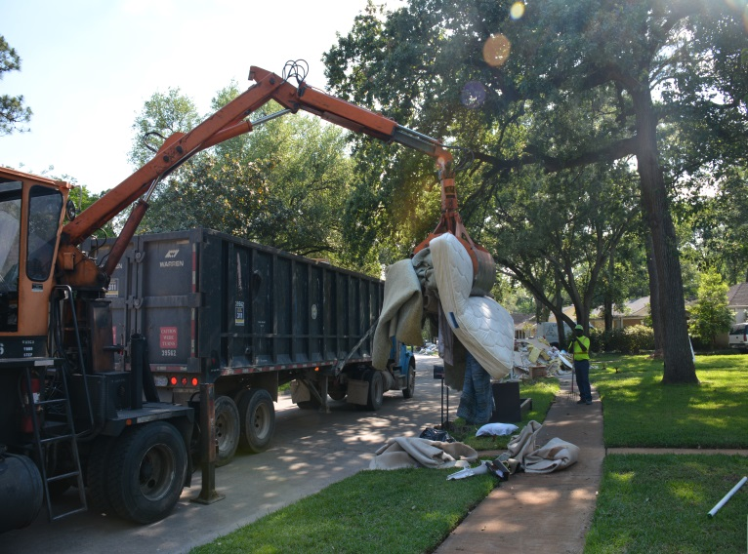
Questions?

