Slide 1

Houston’s Future
Regional Express Transit
Regional Transit Coordination Subcommittee
10.10.19

Slide 2

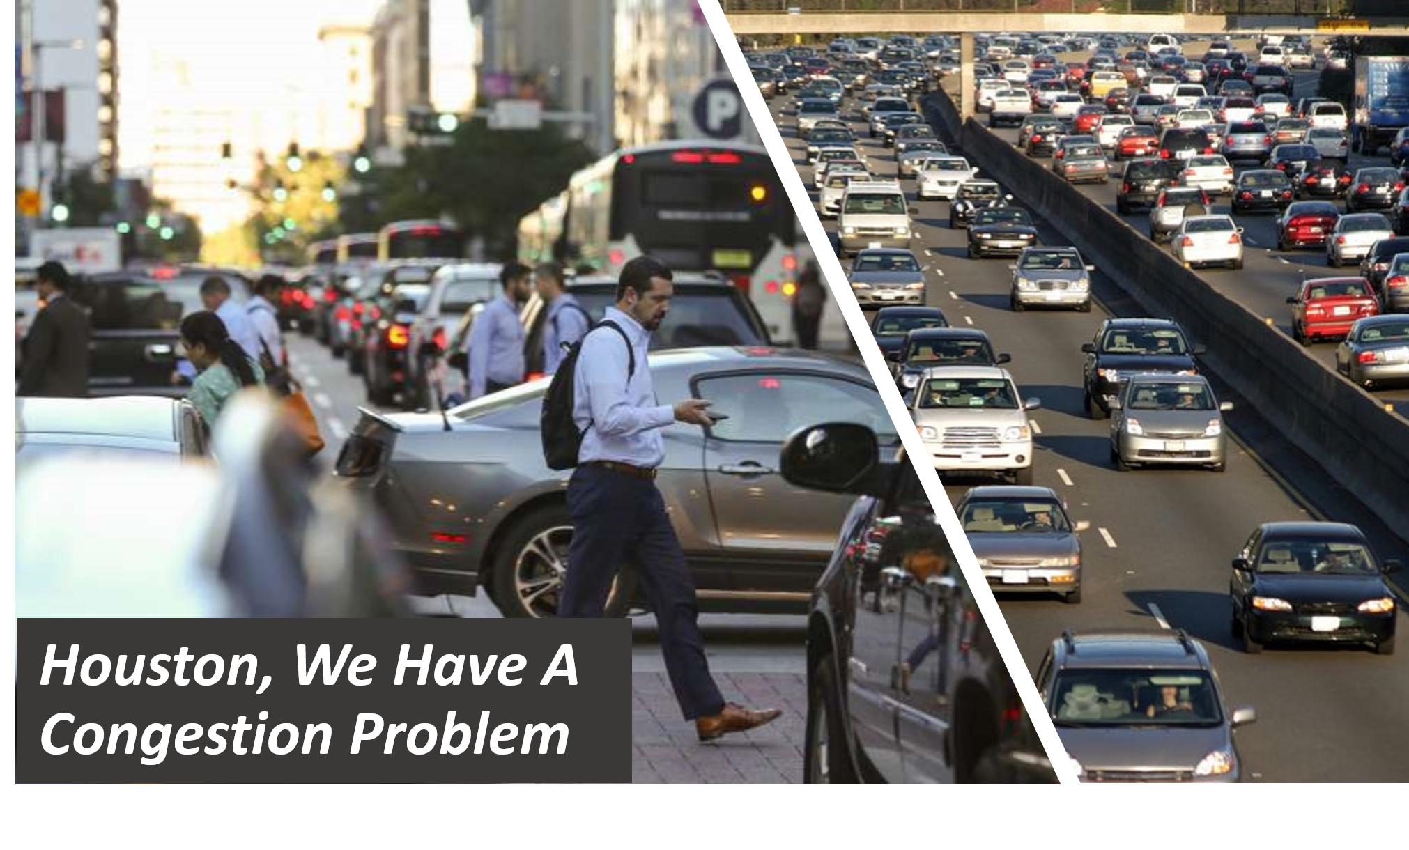
Congestion
2
Notes:
Congestion Drains Society’s Resources:
- Peoples’ time
- Businesses access to employees.
Annual Delay per Houston Auto Commuter
- 53 hours in 2007
- 75 hours in 2017
Delta of 22 hours in one decade
Increase of 41.5%

Slide 3
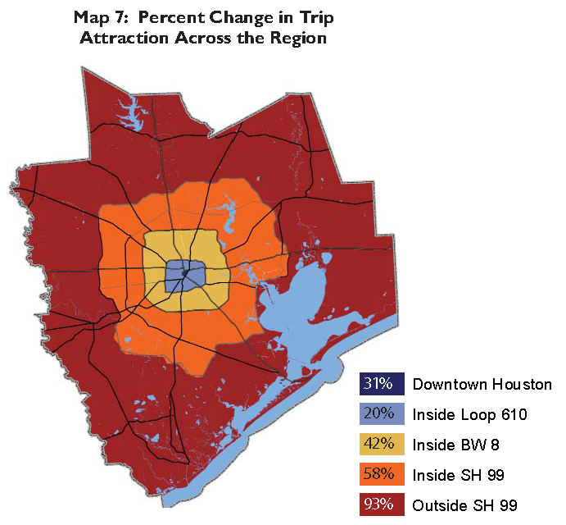
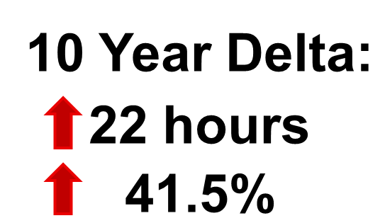
Future Pain Points
Area | 2015 Pop | 2040 Pop | % Change
CBD | 5,501 | 12,927 | 135%
IH-610 | 505,413 | 583,872 | 16%
BW 8 | 1,680,851 | 2,166,884 | 29%
SH-99 | 2,932,889 | 4,308,476 | 47%
Beyond 99 | 1,327,857 | 2,485,284 | 87%
3
Notes:
— Region continues growing and changing.
— Population/Employment continue spreading outwards
=> Increasing demand on our transportation network
— METRO Service Area: + 2 million residents, 50%
— Regionally: + 3.1 million residents, + 48%
— As the population shifts, so do the employment centers

Slide 4
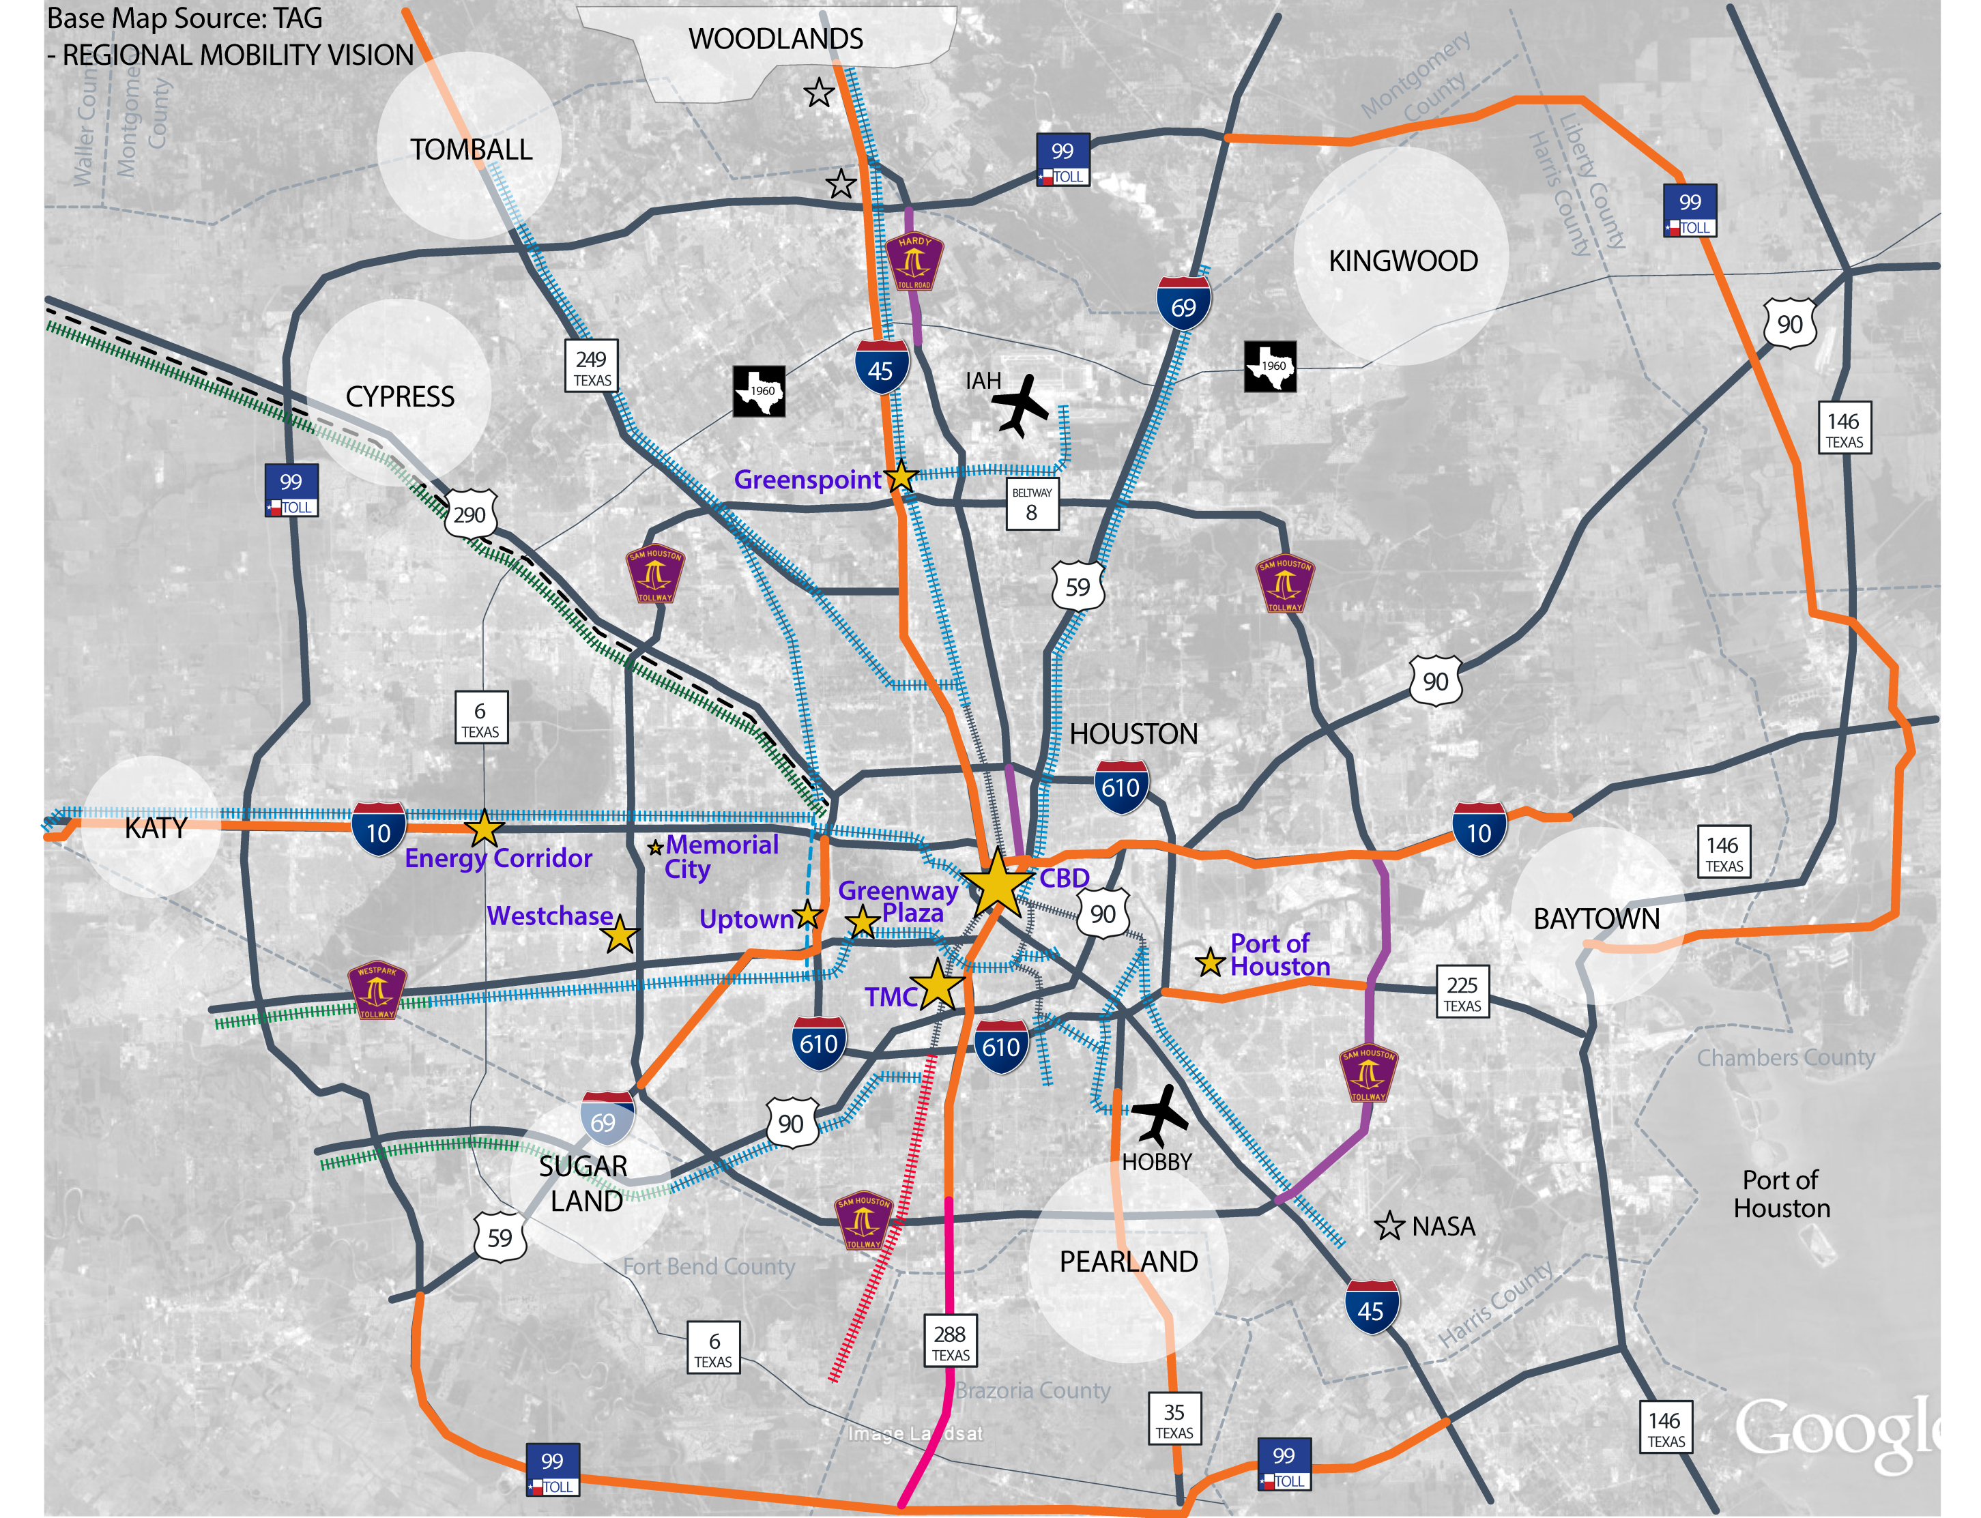
CONNECT ACTIVITY CENTERS
4
Notes:
— Multiple Major Employment Centers
— Top 9 employment centers within the City of Houston
— Employment ranges from approximately 160,000 – 25,000
— How can we connect them all?

Slide 5
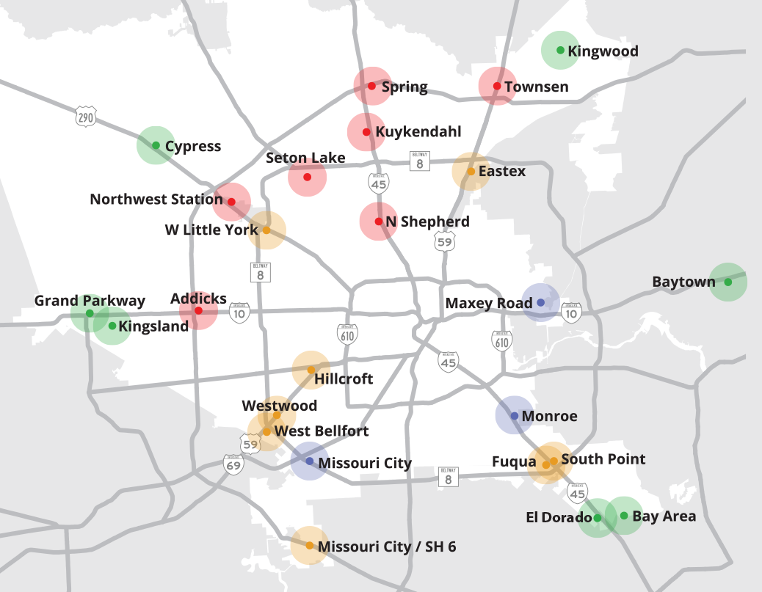

Park & Ride Facilities
3
Notes:
METRO has substantially invested in the Park & Ride system
(2017) METRO Park & Rides served > 31,000 riders per weekday
METRO : 27 Park & Rides
FBCT : 4 Park & Rides
TWT: 3 Park & Rides
Pearland: 1 Park & Ride
Conroe: 1 Park & Ride

Slide 6
Park & Ride Facilities
6
Notes:
With P&R facilities throughout METRO’s Service area and beyond
Our region already has a robust Commuter Transit System!
People Fail to Recognize b/c Service does not stand out
To Increase awareness => We Must Change the Optics

Slide 7
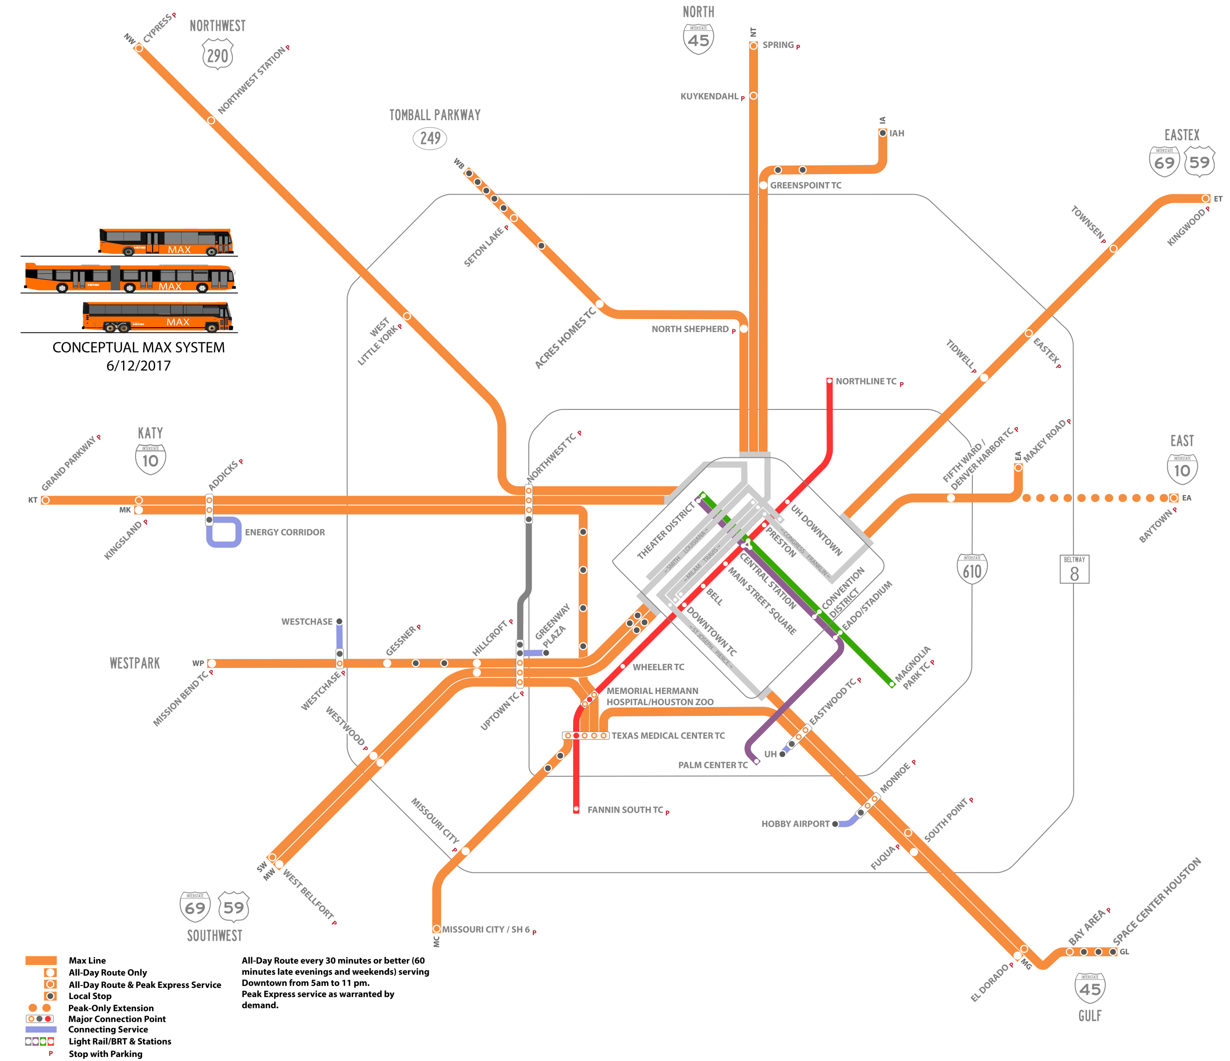
REGIONAL TRANSIT
Proposed System
7
Notes:
Re-envisioned the existing Park & Ride system as rail
Rethink the existing commuter network to increase:
Clarity
Consistency
Visibility

Slide 8
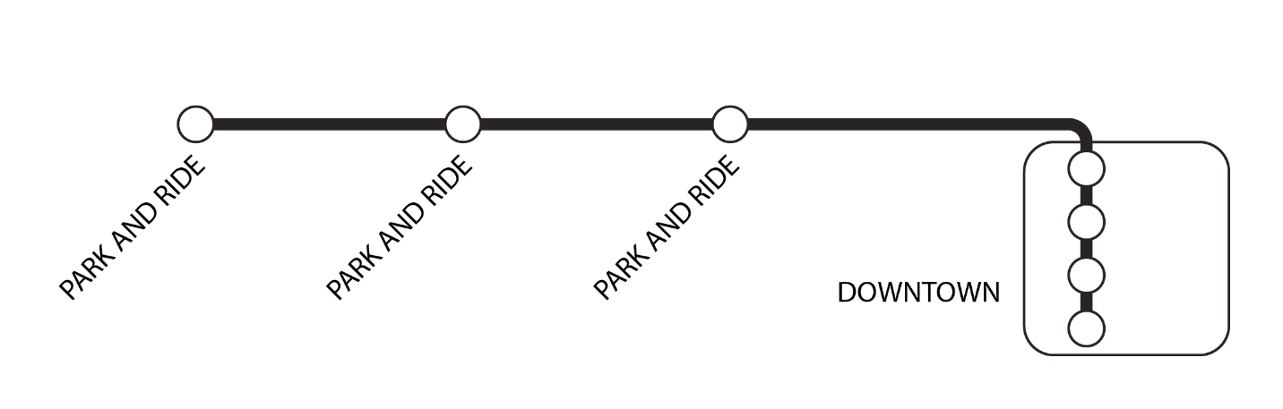
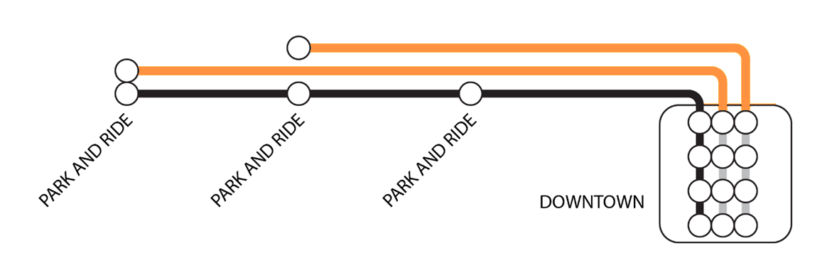
REGIONAL EXPRESS BUS SERVICE
All-Day Base Service - Local Fare
Peak Commuter Service - Premium Fare
8
Notes:
Uniform Base Service along All Corridors:
Bi-directional service
Connecting all the TCs, PRs, & Job Centers (3 to 5 stops)
Operating 7 days a week with consistent service span
Headways of at least every 30 minutes on weekdays
Hourly in the late evenings and on weekends
Base Service = Local Fare $1.25 trips
» Transform the Local Bus Network into Regional Transit Service
» Serve the regions many employment centers
Direct Commuter Service would still exist during Peak Periods
From high demand P&Rs straight to job centers
Direct Service => Premium Fare (Current P&R fee schedule)
Maintaining the Park & Ride service that many know and love

Slide 9
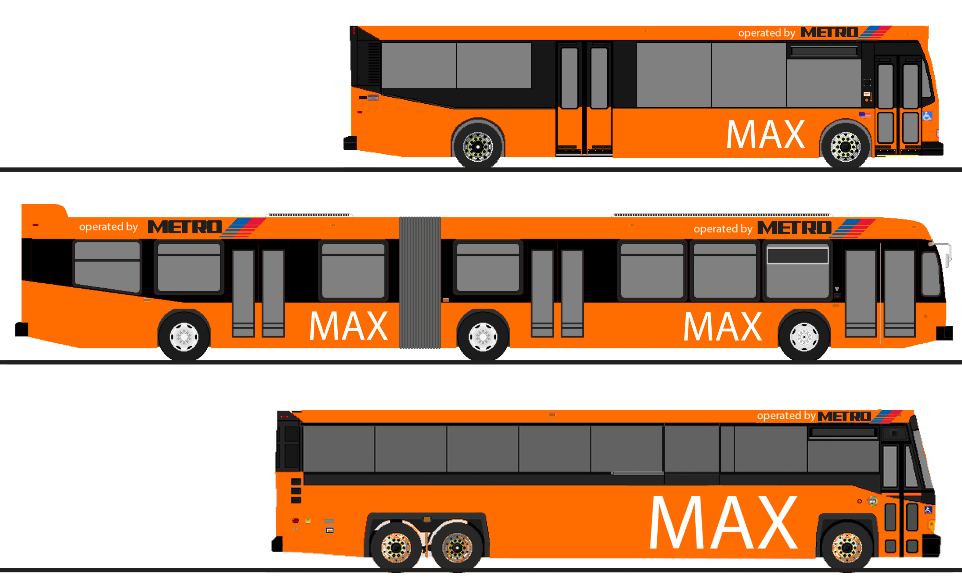
REGIONAL EXPRESS BUS SERVICE
Distinctive Branding
9
Notes:
Distinctive Unique Branding => Immediate Visibility
Obvious to Newcomers to the:
Region
Neighborhoods
Employment Centers

Slide 10
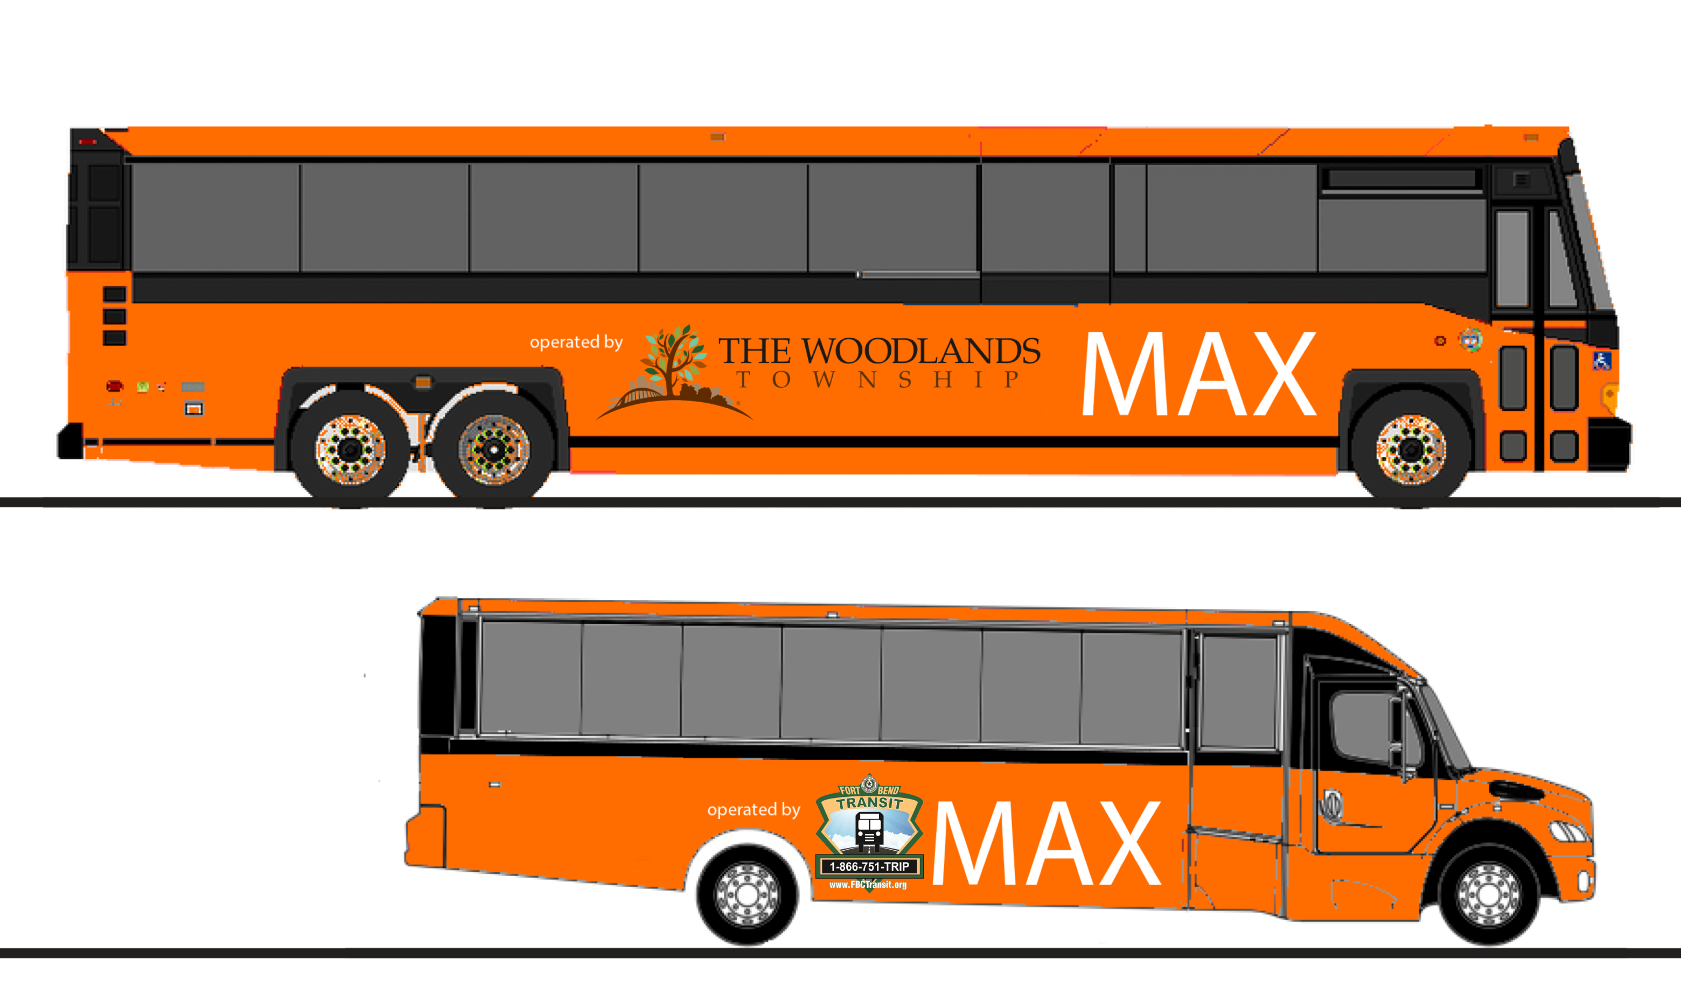
REGIONAL EXPRESS BUS SERVICE
Unique Unified Identity
10
Notes:
Unified System Opportunities:
Shared Branding Across Transit Operators
Integrating other commuter services into the system
METRO MAX + TWT MAX + FBCT MAX
=> MAX Regional Express Bus Service
Shared Simple & Intuitive Labeling on Stops & Signage

Slide 11
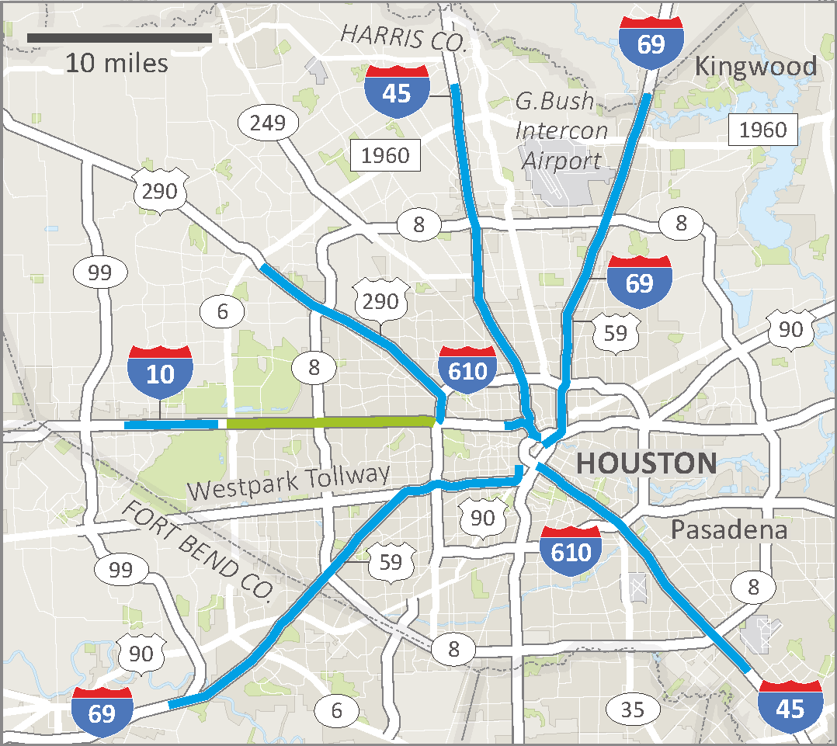
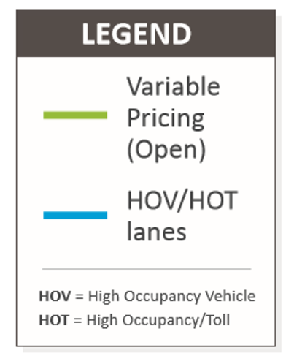
Extensive HOV Lanes
Over 25.4 million users in 2017
11
Notes:
METRO operates 110 miles of the region’s HOV lanes
25.4 million people used METRO HOV/HOT lanes in 2017

Slide 12
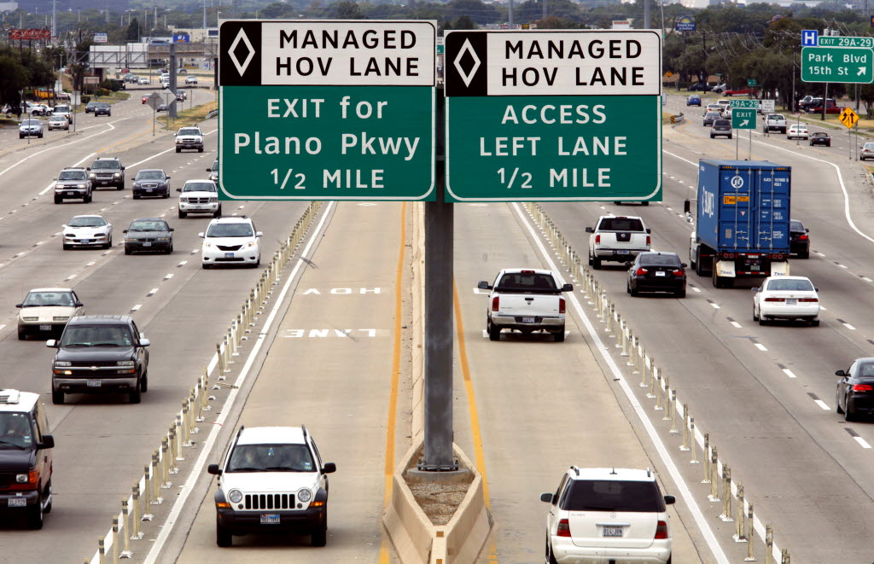
MaX Lanes
12
Notes:
TxDOT has embraced the concept of MaX Lanes
Goal: “move the maximum number of people at maximum speed”
Two Way HOV/HOT Lanes, Along Every Corridor, Operating 24/7
As “peak periods” continue to grow, so do the benefits of 24/7 HOV

Slide 13
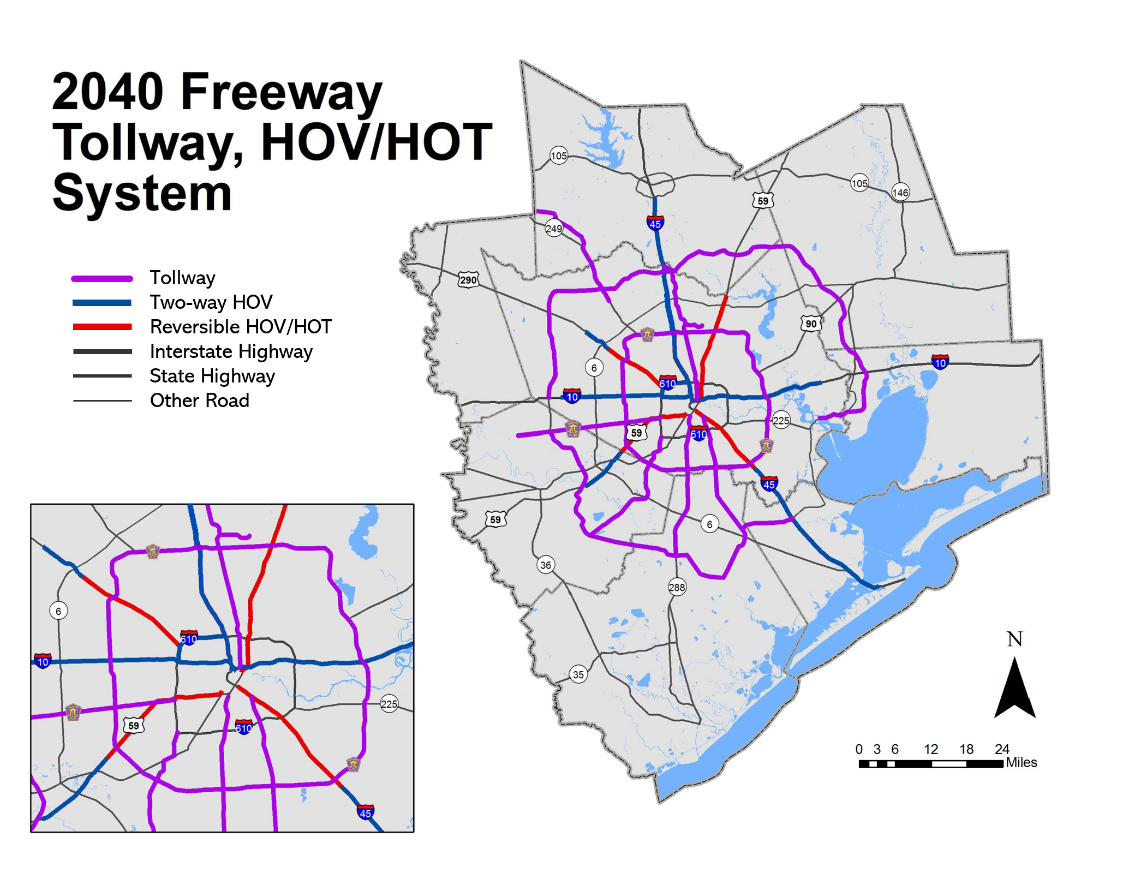
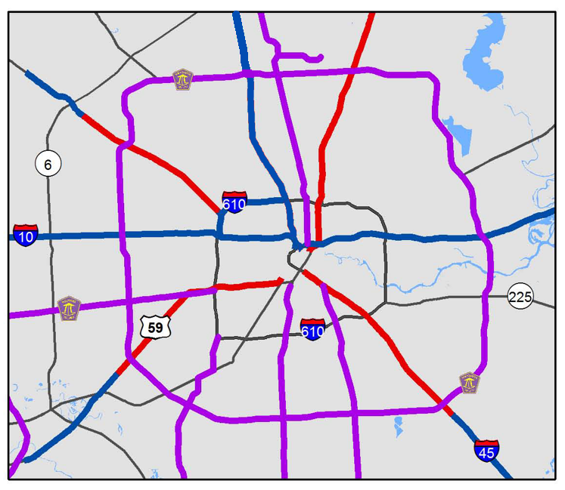
Planned HOV Expansions
13
Notes:
Numerous Expansions HOV/HOT are planned by 2040
Objective: Make HOV Bi-directional Wherever Possible
MAX-imize the advantages of existing and planned HOV/HOT lanes

Slide 14
REGIONAL EXPRESS BUS SERVICE
MAX is:
New Service
New Branding
New Fares
New Infrastructure
Scalable
Affordable
Inclusive
Adaptable
Framework to Change the Service Paradigm
14
Notes:
MAX is:
New service: 2-way, all day, every day, on every freeway
New branding: distinct, intuitive, coherent/consistent information
New fares: the base service integrates with the local bus network
New infrastructure: 2-way HOT/HOV lanes and new transit centers
Getting started is as Easy as 1, 2, 3
New service, branding, and fares can be instituted immediately
New infrastructure implemented incrementally, improving service

Slide 15

  Referendum on November 5, 2019
15
Notes:
Urgency: Referendum must pass to maintain current transit share.
$7.5 billion is really just a drop in the bucket.

Slide 16
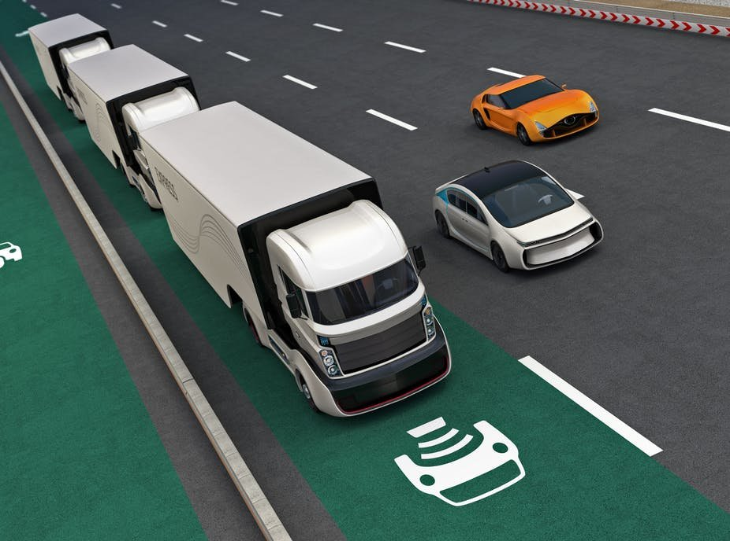
Autonomous Vehicles
Immediate Future: Platooning
16
Notes:
One driver operates multiple vehicles linked by wireless communications. Future of Transit.

Slide 17
Autonomous Vehicles
Driverless AV Bus operations will be possible on Houston’s HOV Lanes within the next five years
17

Slide 18
Autonomous Vehicles
Houston is Uniquely Positioned to
Lead the AV Transit Revolution
18

Slide 19
Thank you!
Katrina Bayer
Transportation Planning Manager
Central Houston, Inc.
kbayer@centralhouston.org
3
Notes:
Any questions?

Slide 20
Centralhouston.org

