Slide 1
Harris County CSD Office of Transit Services Disaster Recovery Harvey - Routes

Slide 2
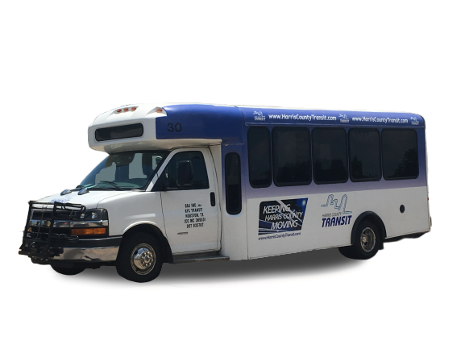
Harris County Transit
Harris County Transit (HCT) applied for Disaster Recovery - Harvey funding in November 2018
Expected to be awarded 3.8 million in December 2019 (Award date vs. HC-court date)
HCT Fixed-Route service will target Harvey affected households
Coordinated 4 public meetings
(1) Leon Grayson Community Center (Precinct 2)
(1) Flukinger Community Center (Precinct 2)
(2) San Jacinto College – North (Precinct 1)

Slide 3
Harris County Transit
Introducing 5 New Routes:
Highlands/Crosby route 6
Baytown Sheldon / Shuttle 11
Channelview route 12
Cloverleaf route 13
Sheldon West route 14
Connection to Houston METRO
Mesa Transit Center
Woodforest / Uvalde
I-10 East / Uvalde

